Slide 1
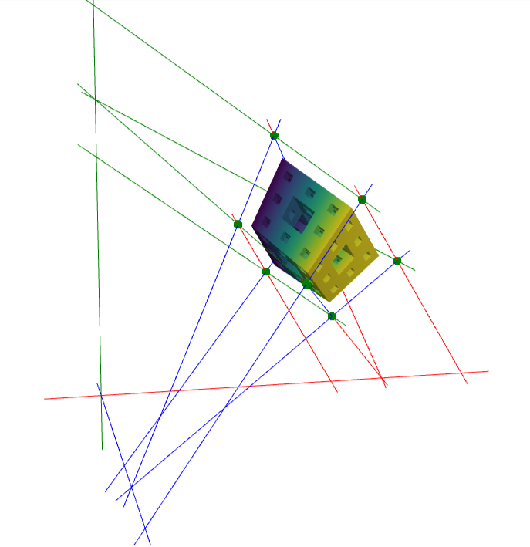
Construction of Birational Multilinear Maps via Tensor Rank Criteria Pablo González-Mazón Università di Trento Joint work with Laurent Busé
5th of April 2024

Slide 2
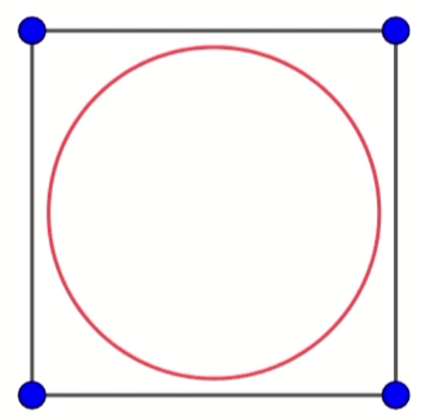
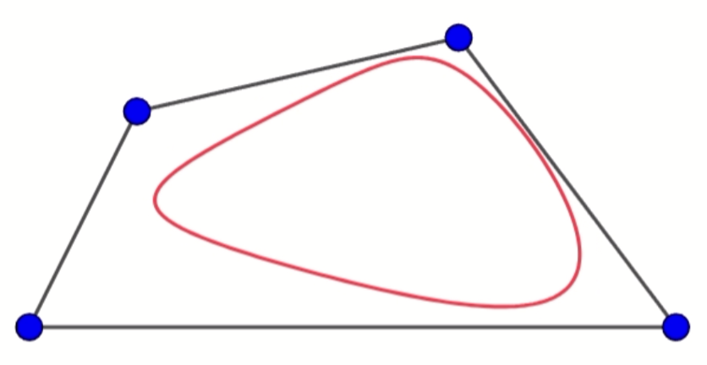
Motivation: Bilinear Birational Maps

Slide 3
Bilinear Rational Maps

Slide 4
Example: A Bilinear Rational Map
They can be regarded as maps from the unit square to quadrilaterals
The weights have a pull-push effect towards the control points

Slide 5
Bilinear Birational Maps: Algebra

Slide 6
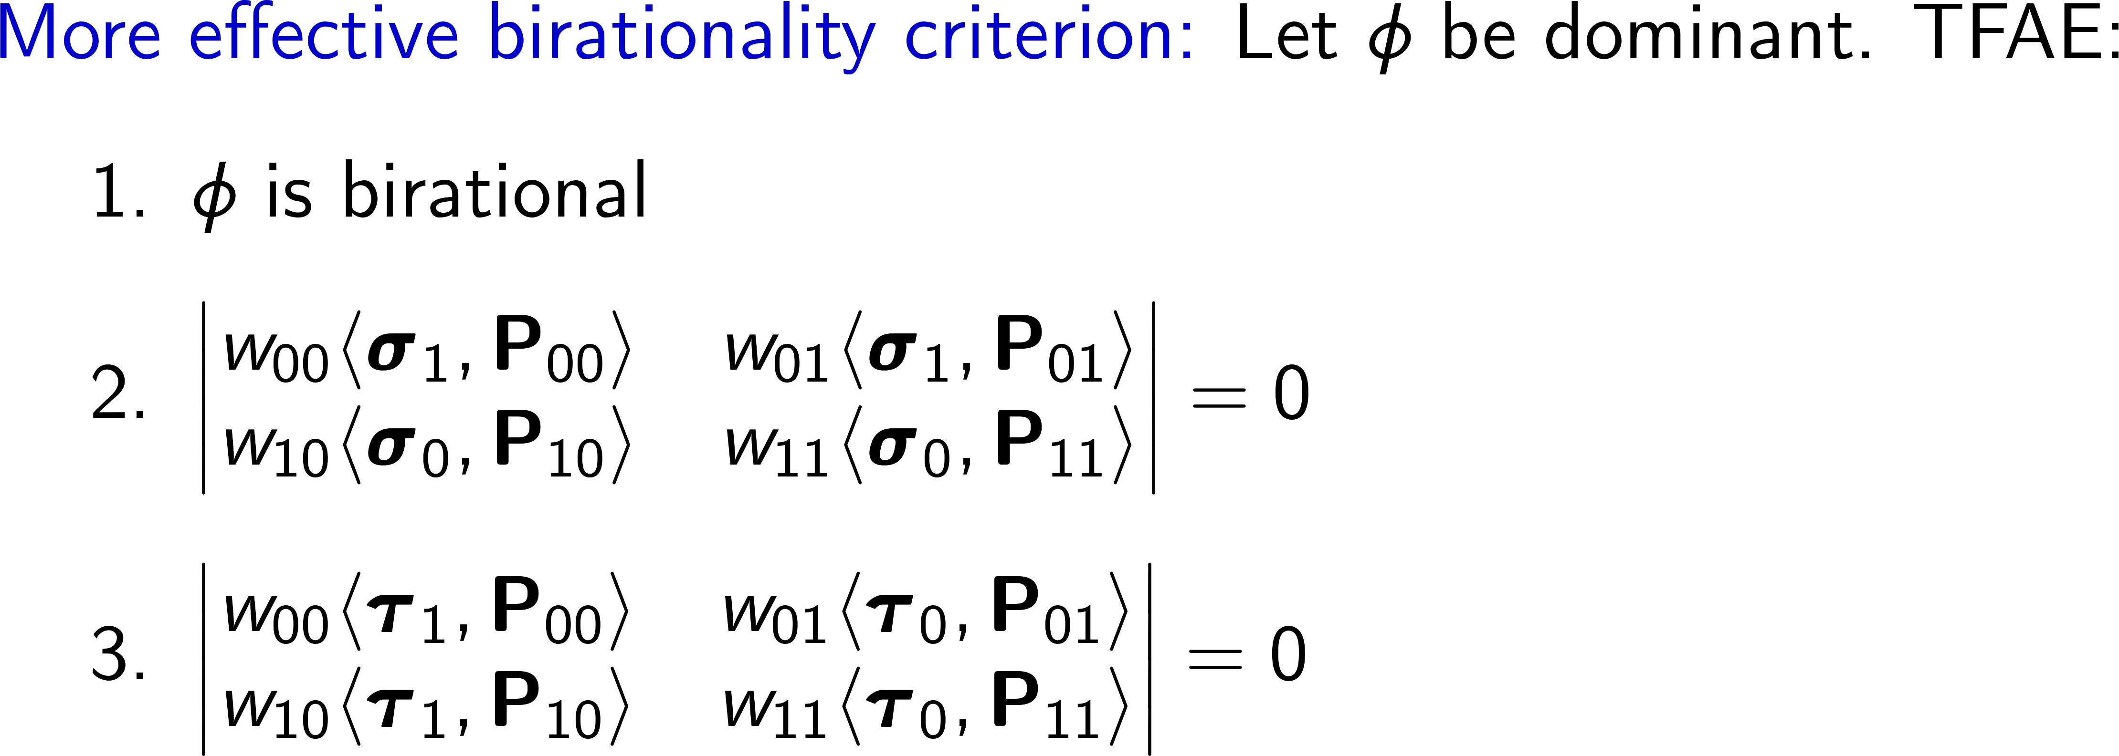
Construction of Bilinear Birational Maps

Slide 7
Bilinear Birational Maps: Construction

Slide 8
Moving to 3D: Motivation

Slide 9
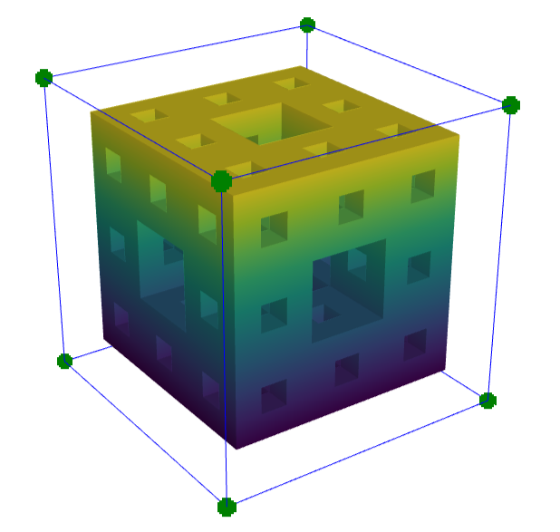
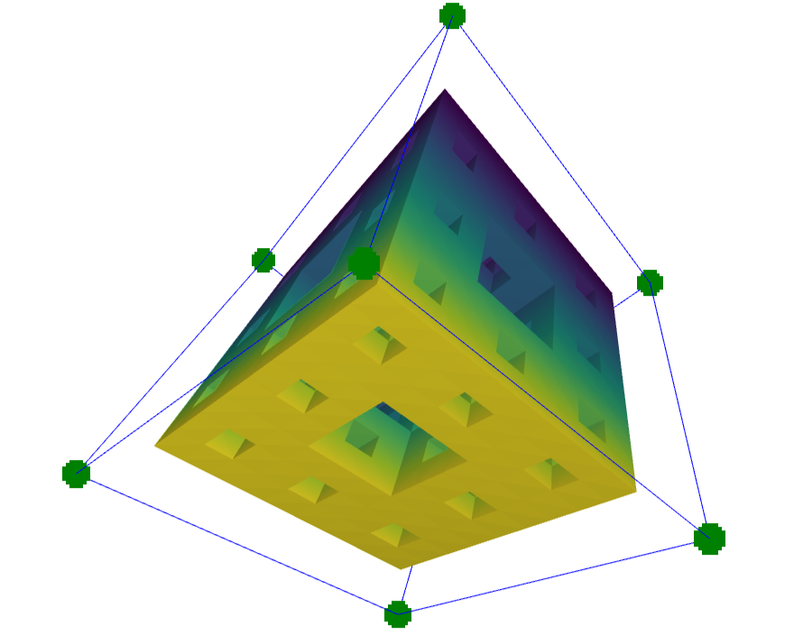
Trilinear Birational Maps: Basic definitions

Slide 10
Control Points and Weights

Slide 11
Example: A Trilinear Rational Map in CAGD

Slide 12
The Type of a Trilinear Map

Slide 13
Syzygy-Based Characterization of Birationality

Slide 14
Boundary Surfaces

Slide 15
Boundary Lines

Slide 16
Control Points of Trilinear Birational Maps

Slide 17
The Four Classes and the Type

Slide 18
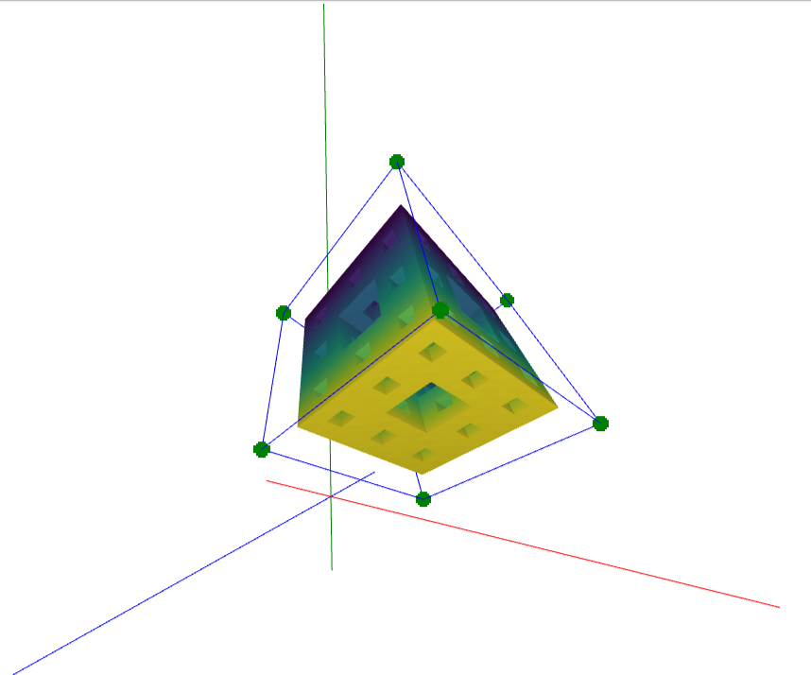
Polypols and Birationality

Slide 19
Example: A “Tripod” Quadric 3D Polypol

Slide 20
(Effective!) Tensor Rank Birationality Criterion

Slide 21
(Effective!) Tensor Rank Birationality Criteria

Slide 22
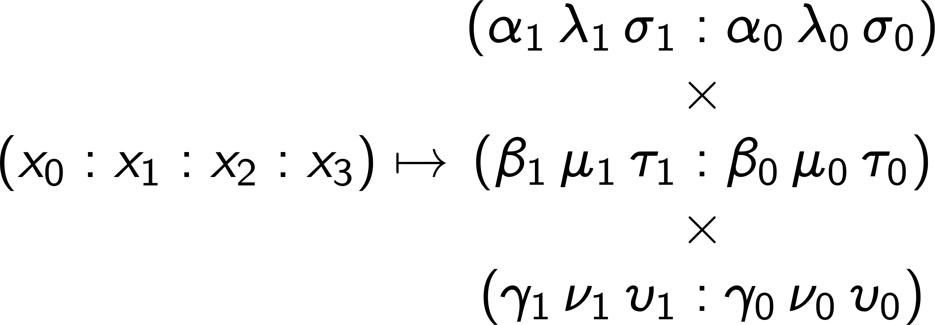
Inverse Rational Map

Slide 23
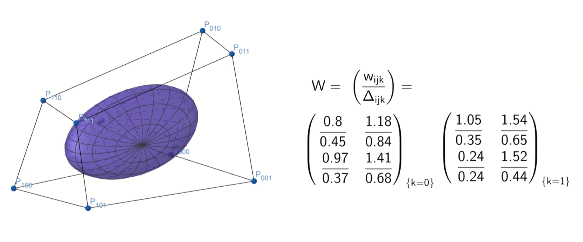
Some Applications

Slide 24
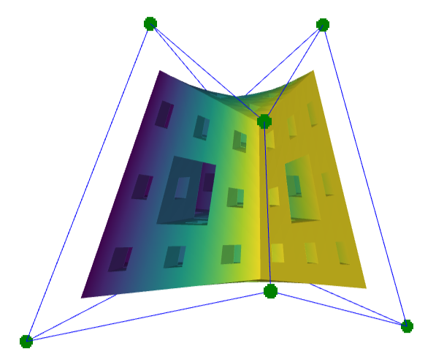
Example: Birational Approximation of a Pyramidal Map

Slide 25
Example: Birational Approximation of a Pyramidal Map

Slide 26
Example: Birational Approximation of a Pyramidal Map

Slide 27
Example: Birational Approximation of a Pyramidal Map

Slide 28
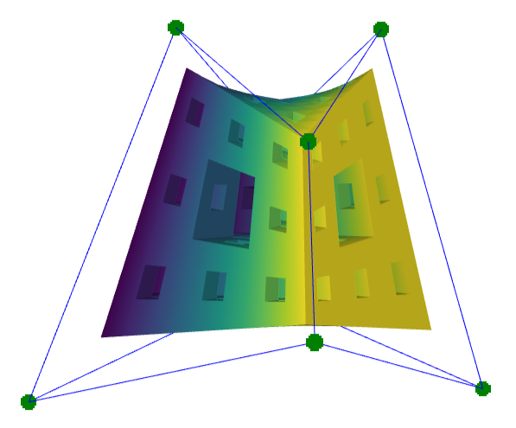
Example: Birational Approximation of a Pyramidal Map

Slide 29
Example: Birational Deformation of a Hexahedral Map

Slide 30
Multilinear Birational Maps in Higher Dimensions

Slide 31
Multilinear Rational Maps

Slide 32
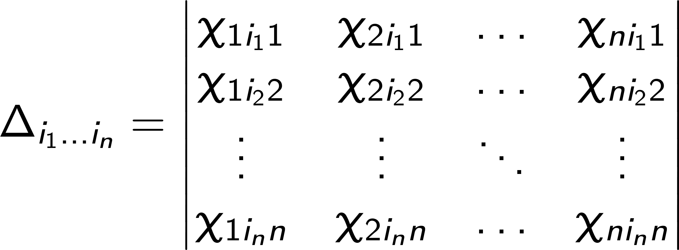
Tensor Rank Birationality Criteria

Slide 33
Inverse and Base Loci

Slide 34
Tensor Rank Birationality Criteria

Slide 35
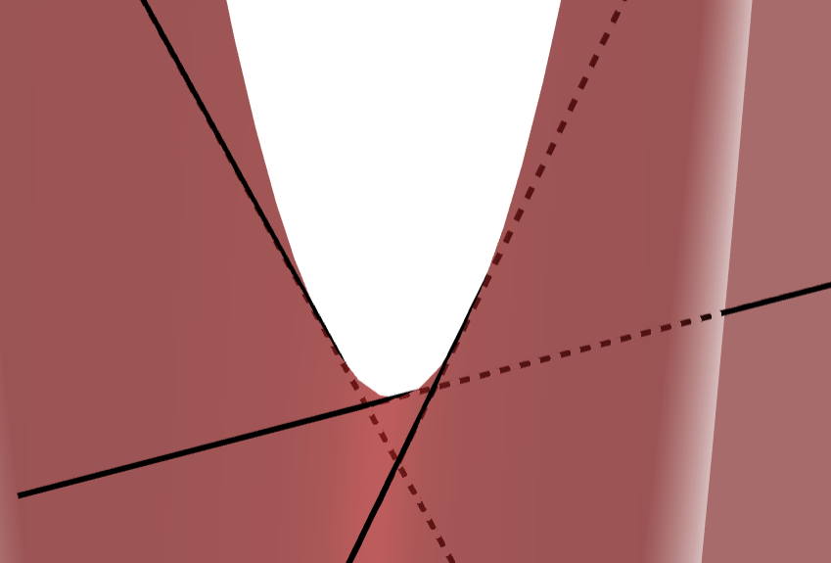
Game: An Algebraic Quiz

Slide 36
Level 1: Easy

Slide 37
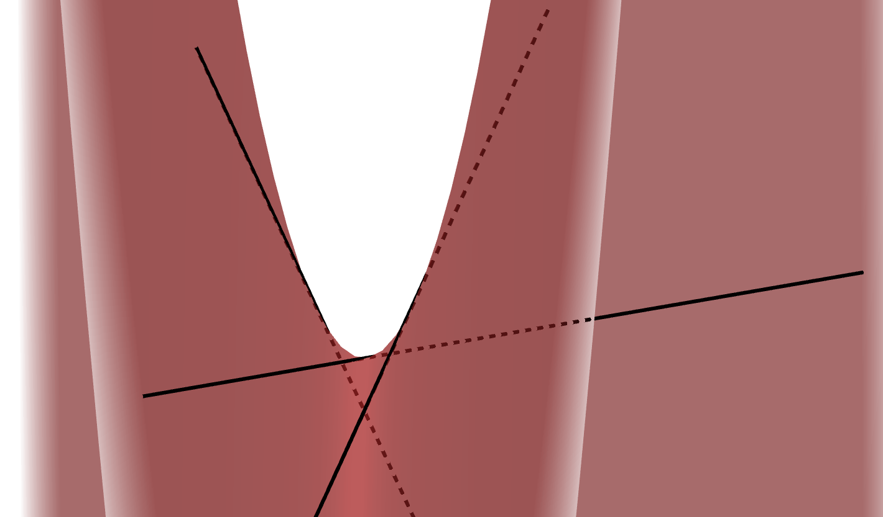
Level 2: Medium

Slide 38
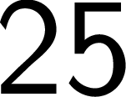
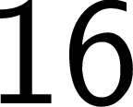
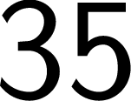
Level 3: Hard

Slide 39
Level 4: Hardcore

Slide 40
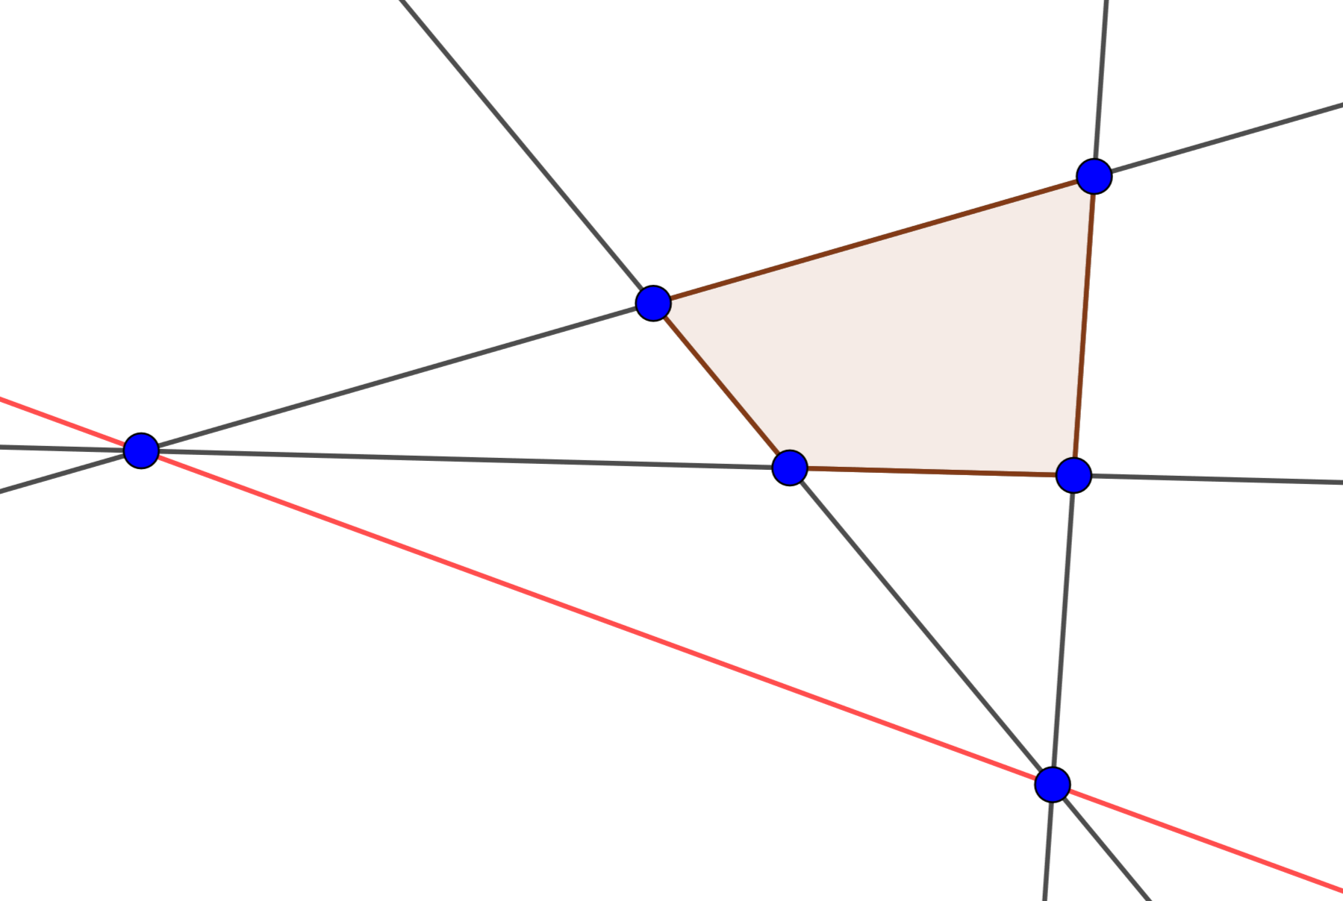
Geometric Interpretation: Level 1

Slide 41
Geometric Interpretation: Level 2

Slide 42
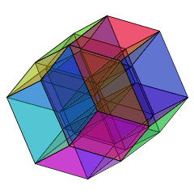
Geometric Interpretation: Level 4

Slide 43
Blow-ups of Multilinear Birational Maps

Slide 44
Thank you ☺

